Slide 1
Long-Term patterns of sediment transport after harvest Summary
Presented by: Timothy Hagen
ES 407 Senior Seminar
Dr. Taylor

Slide 2
Overview of article
Location and setting
Goal of the experiment
Characteristics of WS
Methods
Problems with the experiment
Results
Conclusion and summary

Slide 3
Introduction to article: Setting & Goals

Slide 4
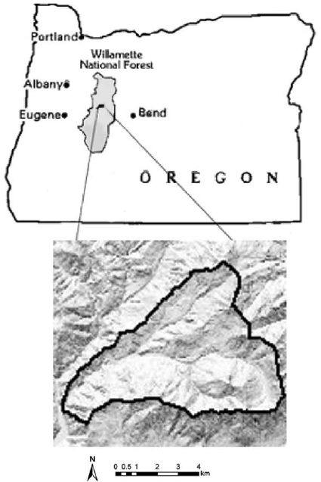
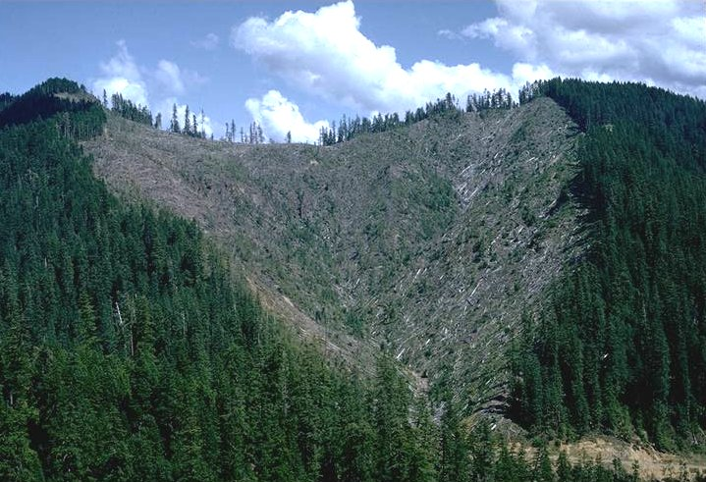
Intro: location and setting
H.J Andrews Experimental Forest
Western Cascade range of Oregon
Volcanic setting
-Dikes
-lava flows
Mass movement
- Debris flow, slides and slumps/ earthflows

Slide 5
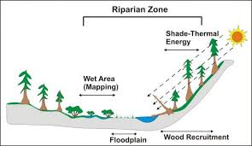
Intro: Goals of the experiment
3 waters sheds
-Clear-cut, roads, control
30 year experiment (1950-1980)
Effects on:
Sediment
bedload and suspended load
Water quality
Channel salability
Riparian ecosystems.

Slide 6
Watersheds & Characteristics

Slide 7
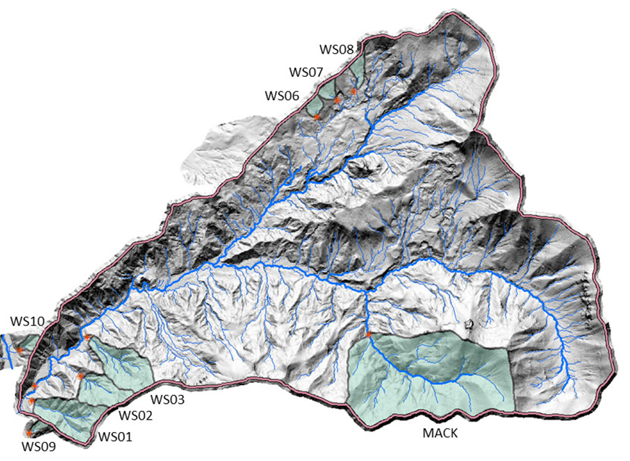
The watersheds
3 watersheds
Clear-cut
Roads/Patch cut
Control
Watersheds selected based on similarities
WS 3: clear-cut
Logged by high lead
WS 1: patch cut with roads
logged by skyline
WS 2: control

Slide 8
Methods of experiment

Slide 9
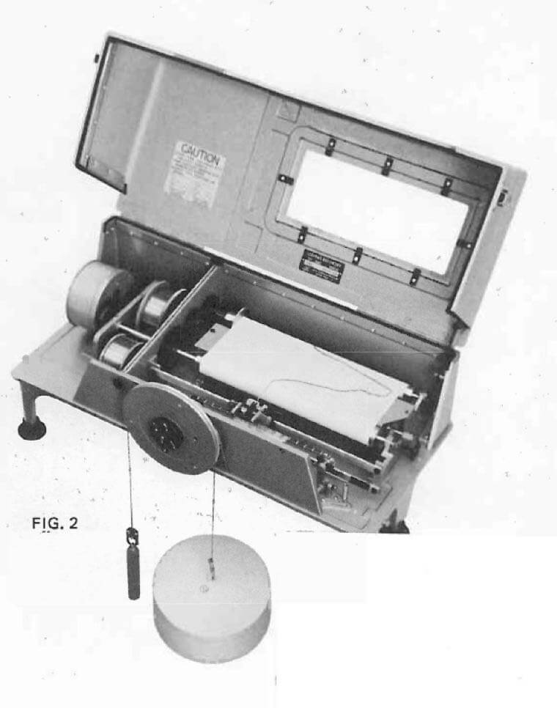
Methods
Monitored by Leopold-Stevens A-35 recorders
Recorded at flumes downstream
Record starts 1958 and ends 1988
Samples of sediment were taken at heads of flumes
Total volumes were reduced by 33% for organics
Sediment yield calculated using empirical models

Slide 10
Results of experiment

Slide 11
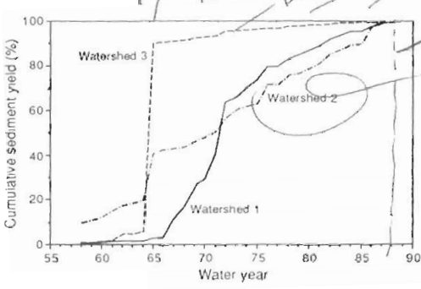
Results: Sediment data
Came up with elaborate models and charts to show data.
Basic results can be summarized by graph here
A lot of factors/outlier data
WS 3 experienced more sediment movement
WS saw most erosion in the first 10 years

Slide 12
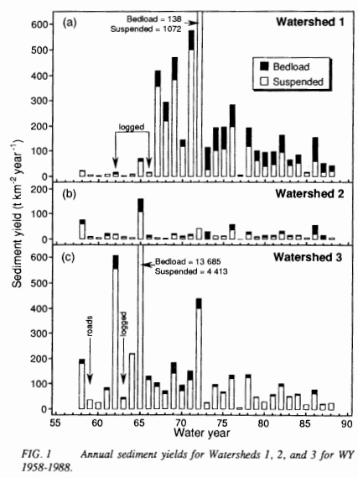

Slide 13
Problems with the experiment

Slide 14
Problems: Size
Similar watersheds, similar size
Watersheds where to small scale for experiment
To get a more accurate account for sediment needs to be on a larger scale

Slide 15
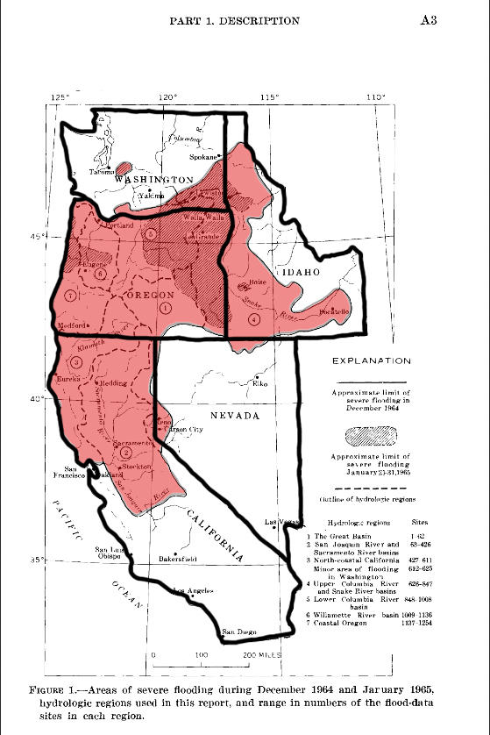
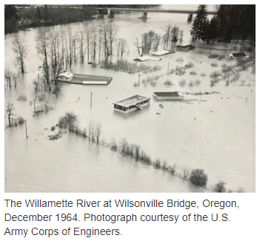
Problems: Storms & Weather
Storms during the experiment caused major issues
Dramatic increase in sediment
Debris flows, and other mass wasting events
1964 storm and other small storms

Slide 16
Conclusion & Summary

Slide 17
Summary
Three watersheds were set up to see the long term effects of sediment erosion after harvest of timber.
One clear-cut, one patch-cut with roads, and a control
Data recorded over a 30 year period
Storms and WS size effected results
Data from the years that were not effected showed that clearcutting had a larger effect on erosion and sediment flow
Patch-cut with roads had an initial high period then leveled out.
Models were made to summaries experiment

Slide 18
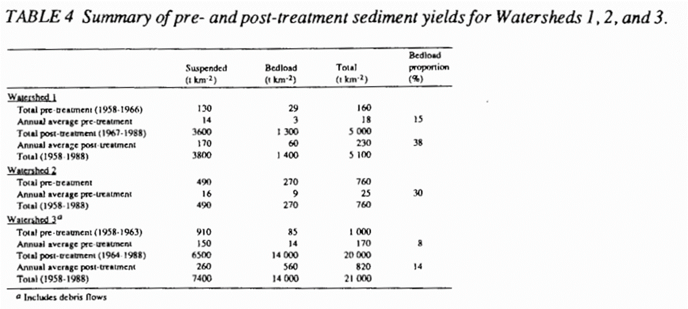

Slide 19
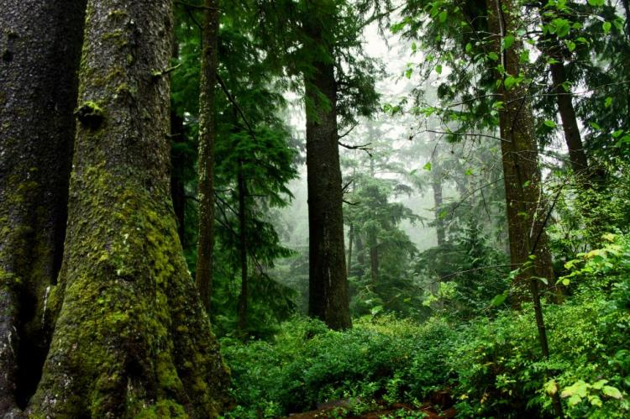
Conclusion
Take this data and use it today for our logging
Much work is to be done yet but improved logging methods and cutting methods have improved on sediment erosion
Learn from our experiments and conduct more with better WS and hopefully get a more accurate account for WS stability in these areas

